Slide 1

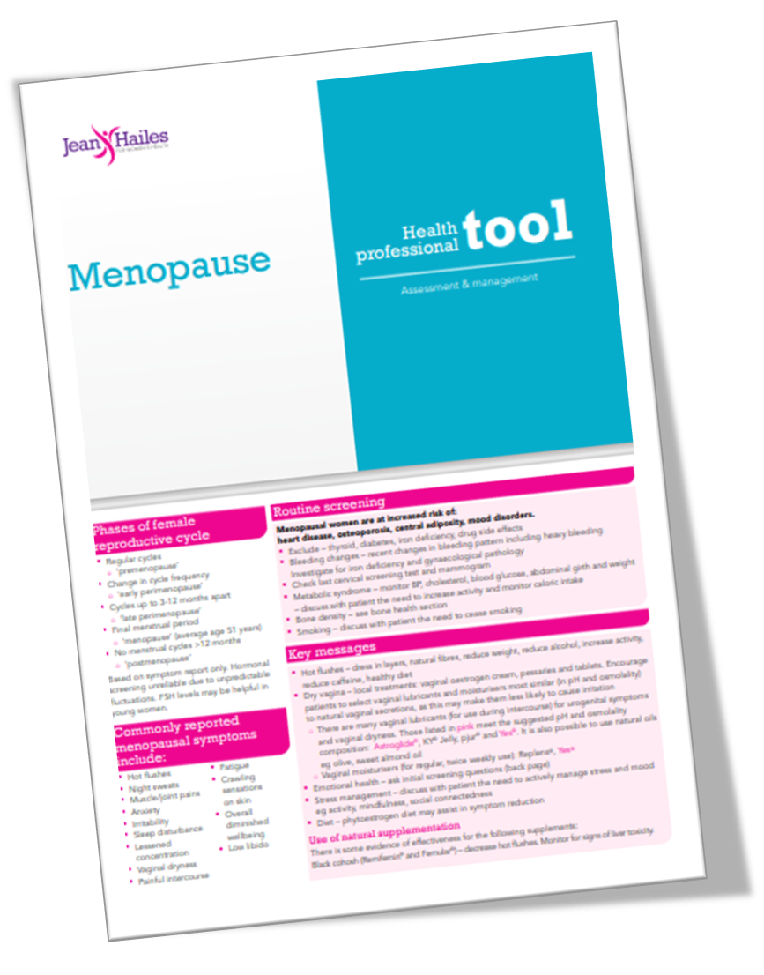

Module 12
Preparing for your Case Study Client
Before you choose your case study client, have you read the PDF titled ‘Choosing your Case Study Client’?
This PDF provides information about the case study process and things to think about before you choose your client.
Step 1: Participant identification, risk stratification, and enrolment
What AGE is your client? Is she in the right age-bracket for natural menopause?
What STAGE of menopause is she in? How have you determined this? [Explore the Jean Haile's Menopause Rating Toolkit for Health Professionals].
What are her current SYMPTOMS? Check these against the commonly known symptoms of menopause based on the Menopause Symptom Scale.
What INTERVENTIONS do you think she requires and do these fit into your scope of practice? Please note, that if she is already under a Menopause Clinic or a Dietician, then is she prepared to work with you, or will her other advice conflict with your intervention?
Step 2: Initial assessment and screening
Use your health screening form to evaluate factors such as past and current medical history, risk factors for chronic disease, current medications, self-reported health status. If she identifies as a complex client, please have a think about whether you are prepared to take her on for this exercise. Feel free to email me should you have any questions.
Use your health screening form to evaluate her current lifestyle – e.g. current diet, amount of exercise she is doing, job hours etc. What obstacles to lifestyle change has she experienced in the past?
Use your health screening form to identify if she is overweight or underweight? Is she on any diets that might interfere with the Mediterranean dietary approach?
Try to evaluate her ‘readiness for change’. Is she going to try the changes you suggest? Sometimes it is very hard to reveal this in the first session, and you may find out afterwards. In that case, you just need to do the best you can, and revisit the behaviour change modules for ideas.
Dr Wendy Sweet (PhD) ©

Slide 2
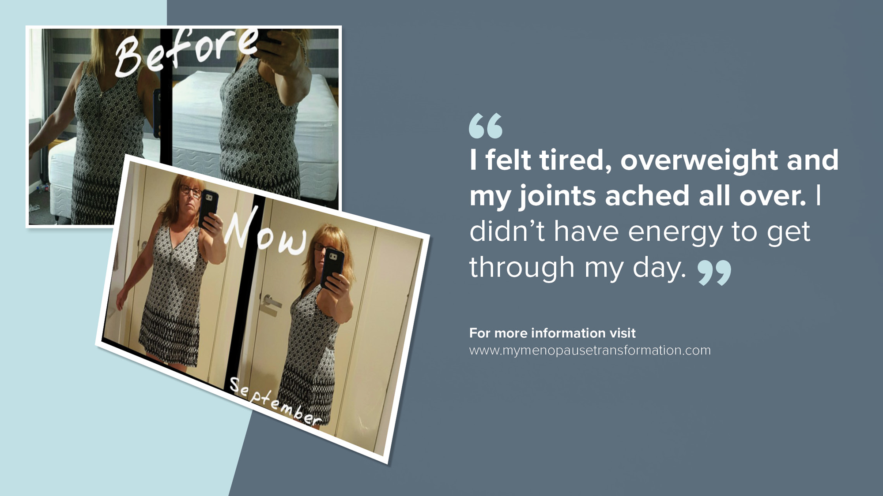
Module 12
Preparing for your Case Study Client
Step 3: Goal setting
Short- and long-term goals.
Guideline-based goals, help clients formulate key, specific action-based, realistic, and time-line driven goals that the client can realistically accomplish.
Step 4: Action plan formulation
Do you need to ger her to do a health check with Doctor?
You could use your course modules to structure your sessions. Start small, so that she doesn’t feel overwhelmed with lots of information.
Step 5: Review of goals and action plan
Step 6: Action plan implementation
Step 7: Follow-up assessment
Step 8: Progress reports
Step 9: Maintenance phase
More to come on this in Week 12
Step 10: Outcome, Assessment, Results
Dr Wendy Sweet (PhD) ©

